Slide 1
Corporate Internal Audit Team Update - New and extended Programs (UK – Certification Office)
17th January 2013

Slide 2
Presenters..
Richard Bristow
- CPD, PPE, MED NB Certification Decision Maker
Steve McRoberts
- PDE Medical Notified Body
David Snook
- Engineering Leader ITE Group
- MCS Certification Decision Maker
Andy Parry
- Project Engineer, ITE Group
Karl Harland
- Quality Manager

Slide 3
Agenda
European/UK Accreditation developments
Notified Body Activity
Construction Products Directive (CPD)
Marine Equipment Directive (MED)
Personal Protective Equipment Directive (PPE)
Medical Notified Body (MDD & IVD)
Other Programs
Accredited and Non Accredited (ITE) EN Evaluations
Microgeneration Certification Scheme (MCS)

Slide 4
European/ UK Accreditation developments and requirements

Slide 5
Accreditation developments
‘Accreditation for Notification’ - EU Regulation 765-08
- From 2013 Assessment year
‘System 1 +’
‘1’ = Primary Std. for Accreditation e.g. EN 45011/Guide 65
‘+’ = the relevant elements of supporting Standards e.g. ISO 17020
EN45011:1998 transitioning to ISO 17065: 2012
- From 2014 Assessment year
- September 2015 deadline

Slide 6
Accreditation requirements
Program
Notified Bodies - The relevant Directive(s) and …. | Primary (1) | + | EA 2/17
Construction Products Directive | EN45011 | ISO 17020 | √
Marine Equipment Directive | EN45011 | ISO 17020 | √
Personal Protective Equipment Directive | EN45011 | ISO 17020 | √
Low Voltage Directive | ISO 17025 | URN 00/800 | √
Medical Notified Body | MHRA GN6 | - | -
Other Programs
Accredited EN evaluations | ISO 17025 | - | -
Microgeneration Certification Scheme | EN45011 | - | -

Slide 7
Construction Products Directive (CPD) Notified Body

Slide 8
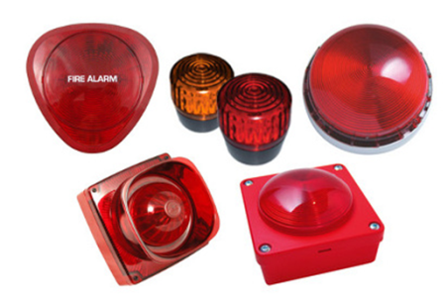
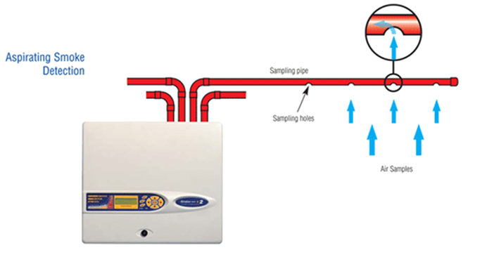
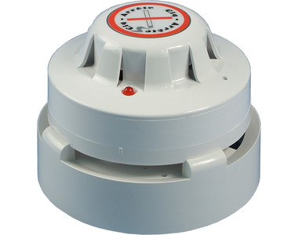
Construction Products Directive (CPD)
Increased scope for Fire detection
EN54-3: Fire alarm devices - Sounders
EN54-10: Flame detectors - Point detectors
EN54-16: Voice alarm control and indicating equipment
EN54-20: Aspirating smoke detectors
EN54-21: Alarm Tx and fault warning routing equipment
EN54-23: Visual alarm devices
EN54-24: Components of voice alarm systems - Loudspeakers
EN54-25: Components using radio links

Slide 9

Construction Products Regulation
Annex I
Transition to Construction Products Regulation
– 1st July 2013
Impacts – mandatory in all member states
– document updates
Assessment process predominantly unchanged
Northbrook perform bulk of the testing currently

Slide 10
CPD - Requirements
Primary Requirement ‘1’ | EN45011 (Guide 65)
‘+’ | ISO 17020
Directive | Construction Products Directive 89/106/EEC
Regulation (from 1st July 2013) | Construction Products Regulation (EU) No 305/2011 (CPR)
Guidance | EA 2/17 CPD Guidance Documents UKAS P16 Assessment of Approved and Notified bodies
Management System | ‘CP’ Department Code
Primary Document | Program Policy (00-CP-P0400)

Slide 11
Marine Equipment Directive (MED) Notified Body

Slide 12

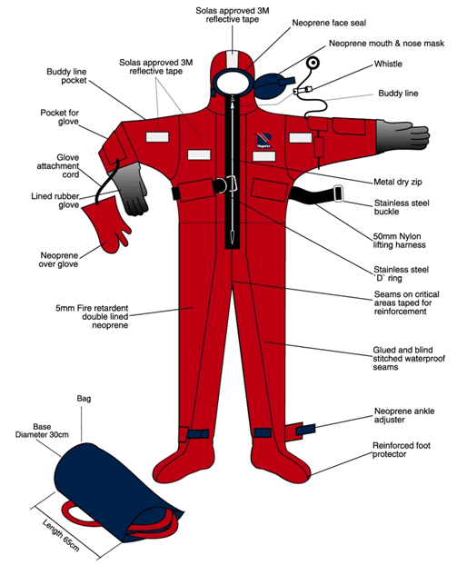


Marine Equipment Directive Notified Body
Life jackets
Immersion suits
Thermal aids
Life Buoys

Slide 13
Marine Equipment Directive Notified Body
New Notified body
Initial Assessment for Accreditation end Q1 2013
Testing by RTP with 3rd Party option
Utilise ‘CIG’ Inspection process
Richard Bristow - Certification Decision Maker
Likely to transition to a Regulation

Slide 14
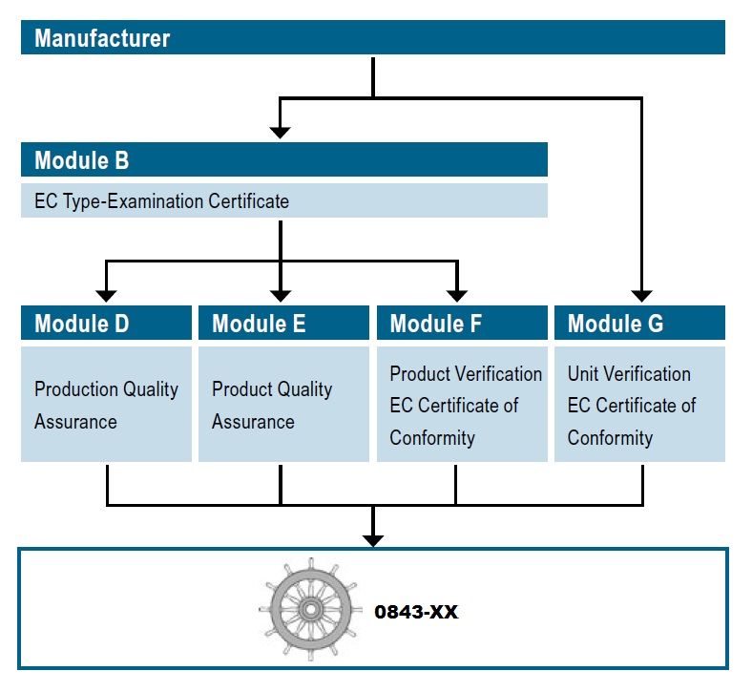
MED Evaluation Process

Slide 15

Testing Standard
International Maritime Organisation - Life Saving Appliances Code
Maritime Safety Committee
IMO Res. MSC.81 (70) – Adopted on 11th December 1998

Slide 16
MED Module Descriptions (Annex B)
EC TYPE-EXAMINATION (MODULE - B)
A notified body must ascertain and attest that a specimen, representative of the production envisaged, complies with the provisions of the international instruments that apply to it…
PRODUCTION QUALITY ASSURANCE (MODULE - D)
The manufacturer must operate an approved quality system for production, final-product inspection and testing as specified and must be subject to surveillance as specified…
PRODUCT QUALITY ASSURANCE (MODULE - E)
The manufacturer must operate an approved quality system for final inspection and testing as specified, and must be subject to surveillance as specified…
PRODUCT VERIFICATION (MODULE - F)
A manufacturer must check and attest that the products conform to the type as described in the EC type-examination certificate by Verification by examination and testing of every product by the Notified Body…

Slide 17
MED - Requirements
Primary Requirement ‘1’ | EN45011 (Guide 65)
‘+’ | ISO 17020
Directive | Marine Equipment Directive 96/98/EC
Guidance | EA 2/17
Management System | ‘MD’ Department Code
Primary Document | Program Policy (00-MD-P0400) (Currently being written)

Slide 18
Personal Protective Equipment Directive (PPE) Notified Body

Slide 19
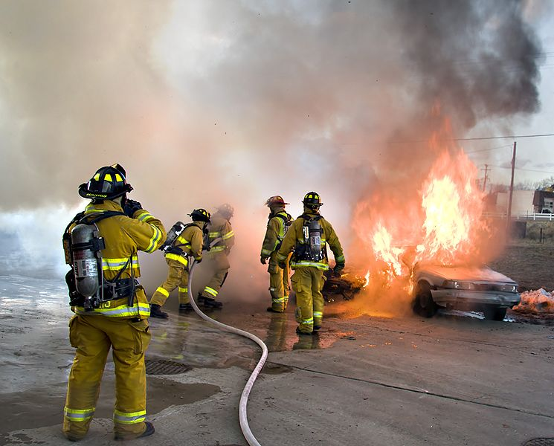
Personal Protective Equipment Notified Body - Extension to scope
Helmets
Hoods
Gloves
Garments
Footwear
+ Fall protection ropes and accessories

Slide 20
Impact of extension to scope
Current scope - Article 10 EC Type Examination
Additional evaluation methods:
Article 11 - CHECKING OF PPE MANUFACTURED:
‘EC’ quality control system for the final product. OR
System for ensuring EC quality of production by means of monitoring.
‘CIG’ approach

Slide 21
PPE Requirements
Primary Requirement ‘1’ | EN45011 (Guide 65)
‘+’ | ISO 17020
Directive | Personal Protective Equipment Directive 89/686/EEC
Guidance | EA 2/17 PPE Guidance Documents (bottom of page) URN 98/981 PPE Guidelines for appointing approved bodies UKAS P16: Assessment of Approved and Notified Bodies BIS: Guidelines for organisations seeking approved body status to undertake testing and certification of personal protective equipment
Management System | ‘PE’ Department Code
Primary Document | Program Requirements 27-PE-P0400 (to become 00-PE-P0400)

Slide 22
Medical (Medical Devices (MDD) and In-vitro Diagnostics Devices (IVDD) Directives) Notified Body

Slide 23
Accredited and Non Accredited (ITE) EN evaluations

Slide 24

Accredited and Non Accredited (ITE) EN evaluations
Program established to support RFI initially
Focused on EN 60950
E.g. Radio & Telecommunications Terminal Equipment (R&TTE)
Act as a Subcontractor to RFI
Option to serve customers directly
Output an Accredited or non Accredited evaluation report – no Certification
Utilises our UKAS ISO 17025 Accreditation

Slide 25
Accredited and Non Accredited (ITE) EN evaluations - Requirements
Primary Requirements | ISO 17025
Guidance | UKAS Lab1: Reference to Accreditation for Laboratories URN 11/673: The National Accreditation Logo and Symbols: Conditions for Use by UKAS and UKAS Accredited Organisations (July 2011) Relevant UKAS Publications for Laboratory Accreditation to ISO/IEC 17025 (General link)
Primary Document | Accredited and Non Accredited EN Evaluations UK ITE and Hi Tec Team (27-CA-S0401)

Slide 26
Microgeneration Certification Scheme (MCS)

Slide 27


Microgeneration Certification Scheme (MCS)
MCS certifies Microgeneration technologies used to produce electricity and heat from renewable sources (to take advantage of ‘feed in’ tariff)
Appointed by UK Government – under license, following UKAS Accreditation
Manufacturers of Products and Installers
Evaluation = Type Test and Factory Production Control (CIG Approach)
UK = Certification Office, UL Frankfurt = Evaluation and Testing

Slide 28
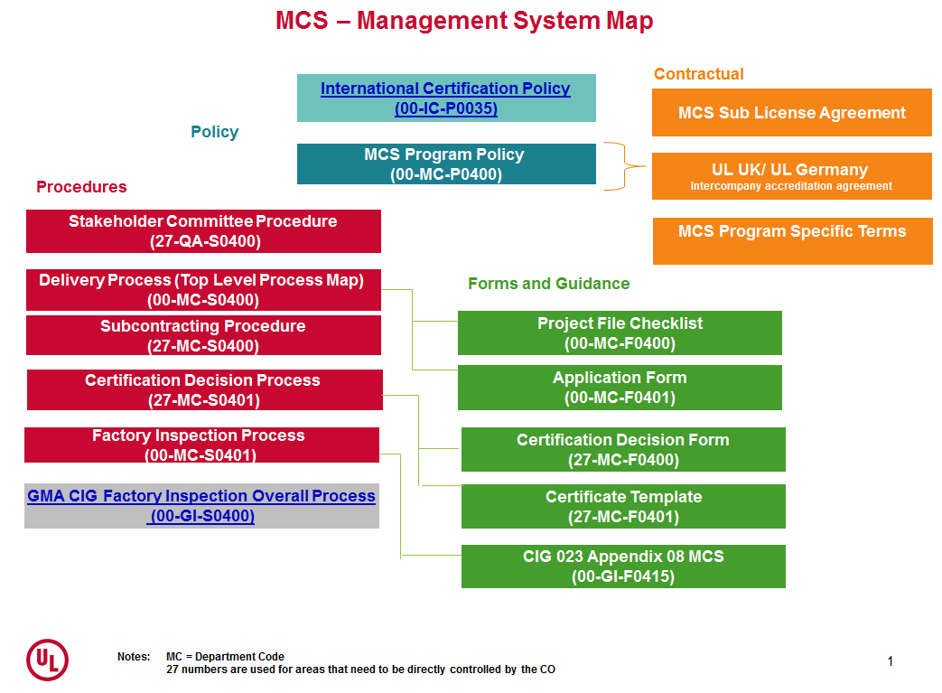
Microgeneration Certification Scheme (MCS)

Slide 29
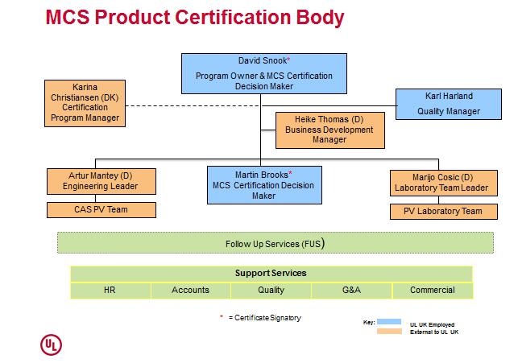

Slide 30
Microgeneration Certification Scheme (MCS)
Primary Requirements | EN 45011 MCS 005 Product Certification Scheme Requirements: Solar Photovoltaic Panels MCS010 Product Certification Scheme Requirements: Factory Production Control Requirements MCS 011 Product Certification Scheme Requirements: Acceptance Criteria for Testing Required for Product Certification
Guidance | EA 2/17 UKAS C2 General Principles for the Assessment of Certification Bodies for Product Certification IAF GD 5 Guidance on the application of ISO/IEC Guide 65:1996 (Application from 8 December 2007)
Management System | ‘MC’ Department Code
Primary Document | Program Policy (00-MC-P0400)

Slide 31
Reference (to be used only if needed)

Slide 32

Notified Body Services
CE Marking Services
The marking indicates the product meets the minimum essential requirements as laid down in the respective EU Directive(s).
Uphold the safety of consumers
Manufacturers desire to:
Sell product to other European member states from within Europe
Sell into the European market from outside of Europe
Assure customers (end or intermediary) that their product meets the essential requirements of the relevant Directive.

Slide 33
CPD - European framework
Primary role of organisation
European Commission
On behalf of each Member State, is responsible for proposing and implementing Legislation e.g. the Directives
Member State Government
UK: Department of Communities and
Local Government
Adopting the legislation and establishing the framework for implementation in the Member State
National Competent Authority
UK:FBE Ltd.
Administering the program in the member state:
Administration
Appeals
Stakeholder representation
Designating Body
UK: UKAS
Assess the initial and on-going evaluation of Notified Bodies
Notified Body
UL International (UK) Ltd.
Assess initial and on-going suitability suitability of applicant customers
and their product(s)
Client
Critical role – ensuring their products meet the minimum essential requirements and their management system is maintained to Factory Production Control requirements.

Slide 34
CPD - Delivery and evaluation process
NB
Certification
Decision
Maker
Certification
Decision
Customer
_________
Customer
Enquiry
Commercial/
CS
_________
Establish
Project
Engineering
__________
Project
Planned
Engineering (NB L2)
_______
Project Handling
Engineering
(NB L3)
_________
Review
Field
Services
________
Factory Surveillance
Laboratory
(NB L1)
________
Testing
Field
Services
________
Initial
Factory
Inspection
Evaluation
Conformity System 1 – Type Test + Factory Production Control (FPC) Inspection

Slide 35
PPE - European framework
Primary role of organisation
European Commission
On behalf of each Member State, is responsible for proposing and implementing Legislation e.g. the Directives
Member State Government
UK: Department for Business Innovation
and Skills
Adopting the legislation and establishing the framework for implementation in the Member State
National Competent Authority
UK: Department for Business Innovation
and Skills
Administering the program in the member state:
Administration
Appeals
Stakeholder representation
Designating Body
UK: UKAS
Assess the initial and on-going evaluation of Notified Bodies
Notified Body
UL International (UK) Ltd.
Assess initial and on-going suitability suitability of applicant customers
and their product(s)
Client
Critical role – ensuring their products meet the minimum essential requirements

Slide 36
PPE - Delivery and evaluation process
NB
Certification
Decision
Maker
Certification
Decision
Customer
_________
Customer
Enquiry
Commercial/
CS
_________
Establish
Project
Engineering
__________
Project
Planned
Engineering (NB L2)
_______
Project Handling
Engineering
(NB L3)
_________
Review
Laboratory
(NB L1)
________
Testing
Evaluation
Article 10 – EC Type Test only

Slide 37
Medical Notified Body Requirements
Primary Requirements | MEDDEV: Guidelines relating to medical device Directives MHRA Guidance Note No 6 - Requirements for UK Notified Bodies
Directives | Medical Devices Directive 93/42/EEC In Vitro Diagnostic Medical Devices Directive 98/79/EEC
Guidance | Notified Body Operations Group Guidance MHRA Guidance Note No 19 - Guidance Notes on In Vitro Diagnostic Medical Devices Directive 98/79/EC MHRA Bulletin 4 on Conformity Assessment Procedures MHRA Bulletin 6 - The Notified Body
Management System | ‘NB’ Department Code
Primary Document | Program Policy (00-NB-P0400) – (Major update in progress)

